Slide 1
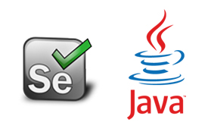
Automation Testing
By- Manas

Slide 2
DATA DRIVEN TESTING
Execute same test script for one/more number of times by passing the data from different sources is called Data Driven Testing. We are performing Data Driven Testing in Selenium in 3 different ways. That mean we can test scripts by passing data from three different sources.
1. From Excel
2. From Notepad
3. From Console

Slide 3
Note:
In Data Driven Testing we are not changing any logic or code in script. We are just passing data from other sources.
From Excel: In this we are executing test scripts by passing data from Excel file.
For reading data from Excel file, we need to configure either JXL.jar file or POI.jar file with Eclipse. It’s not mandatory to use both files, in every project we are using either one of these file to read data from Excel
JXL.jar file doesn’t support latest xlsx file. Before reading data we need to save as the latest Excel file into 97-2003 (.xls) format

Slide 4
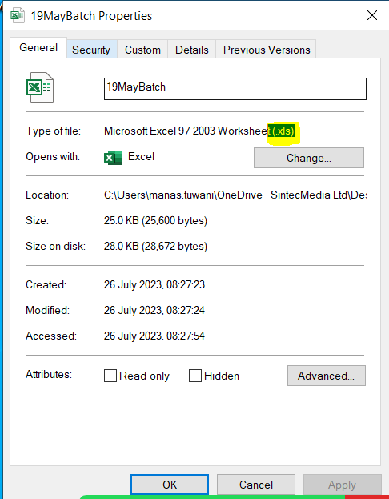
Configuring JXL.jar file
1. Download jxl.jar file -> Open eclipse -> Right Click on Referenced Libraries -> BuildPath -> Configure Build Path -> Click on Add External Jars Button -> Browse jxl.jar ->Click on Apply -> Click on Apply and Close
2. Download it from Maven repository: https://mvnrepository.com/

Slide 5
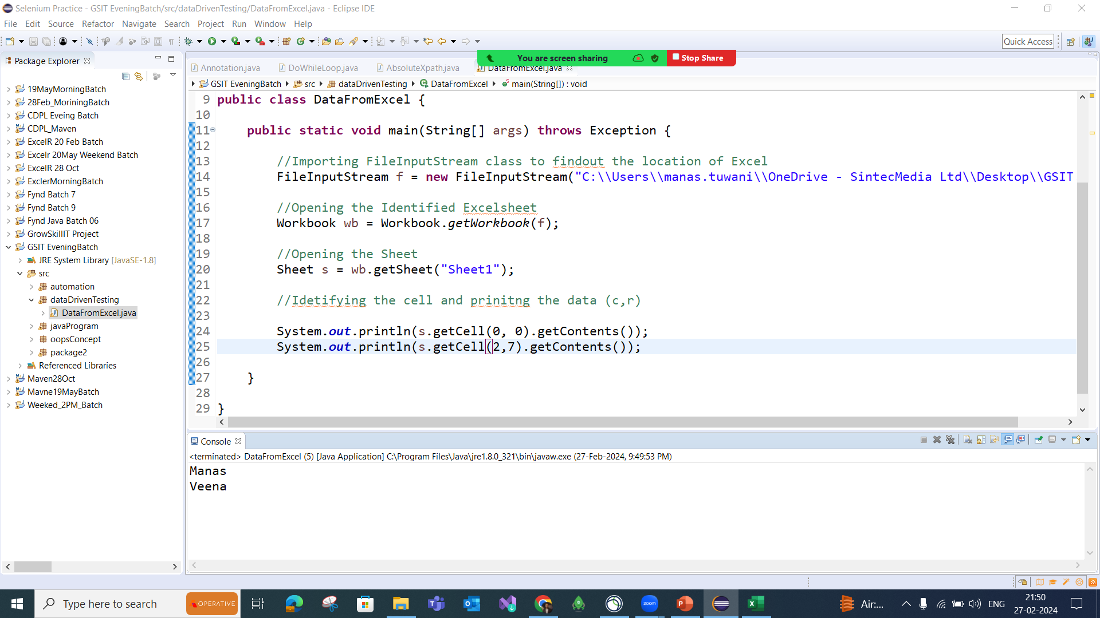

Slide 6
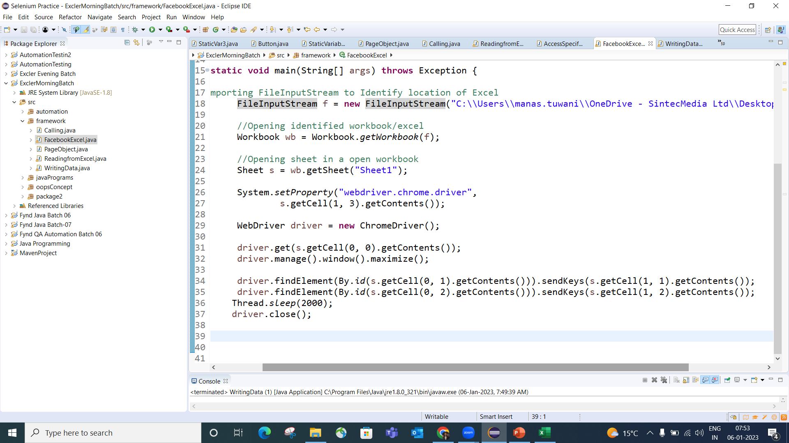

Slide 7
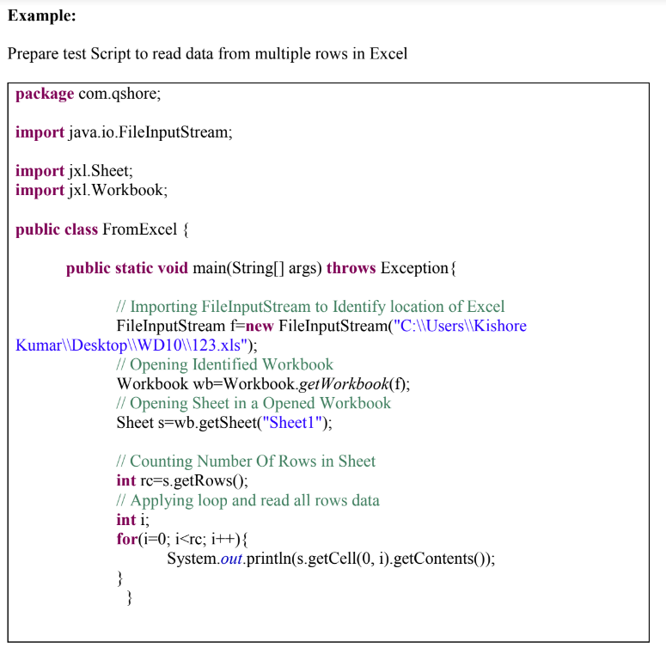

Slide 8
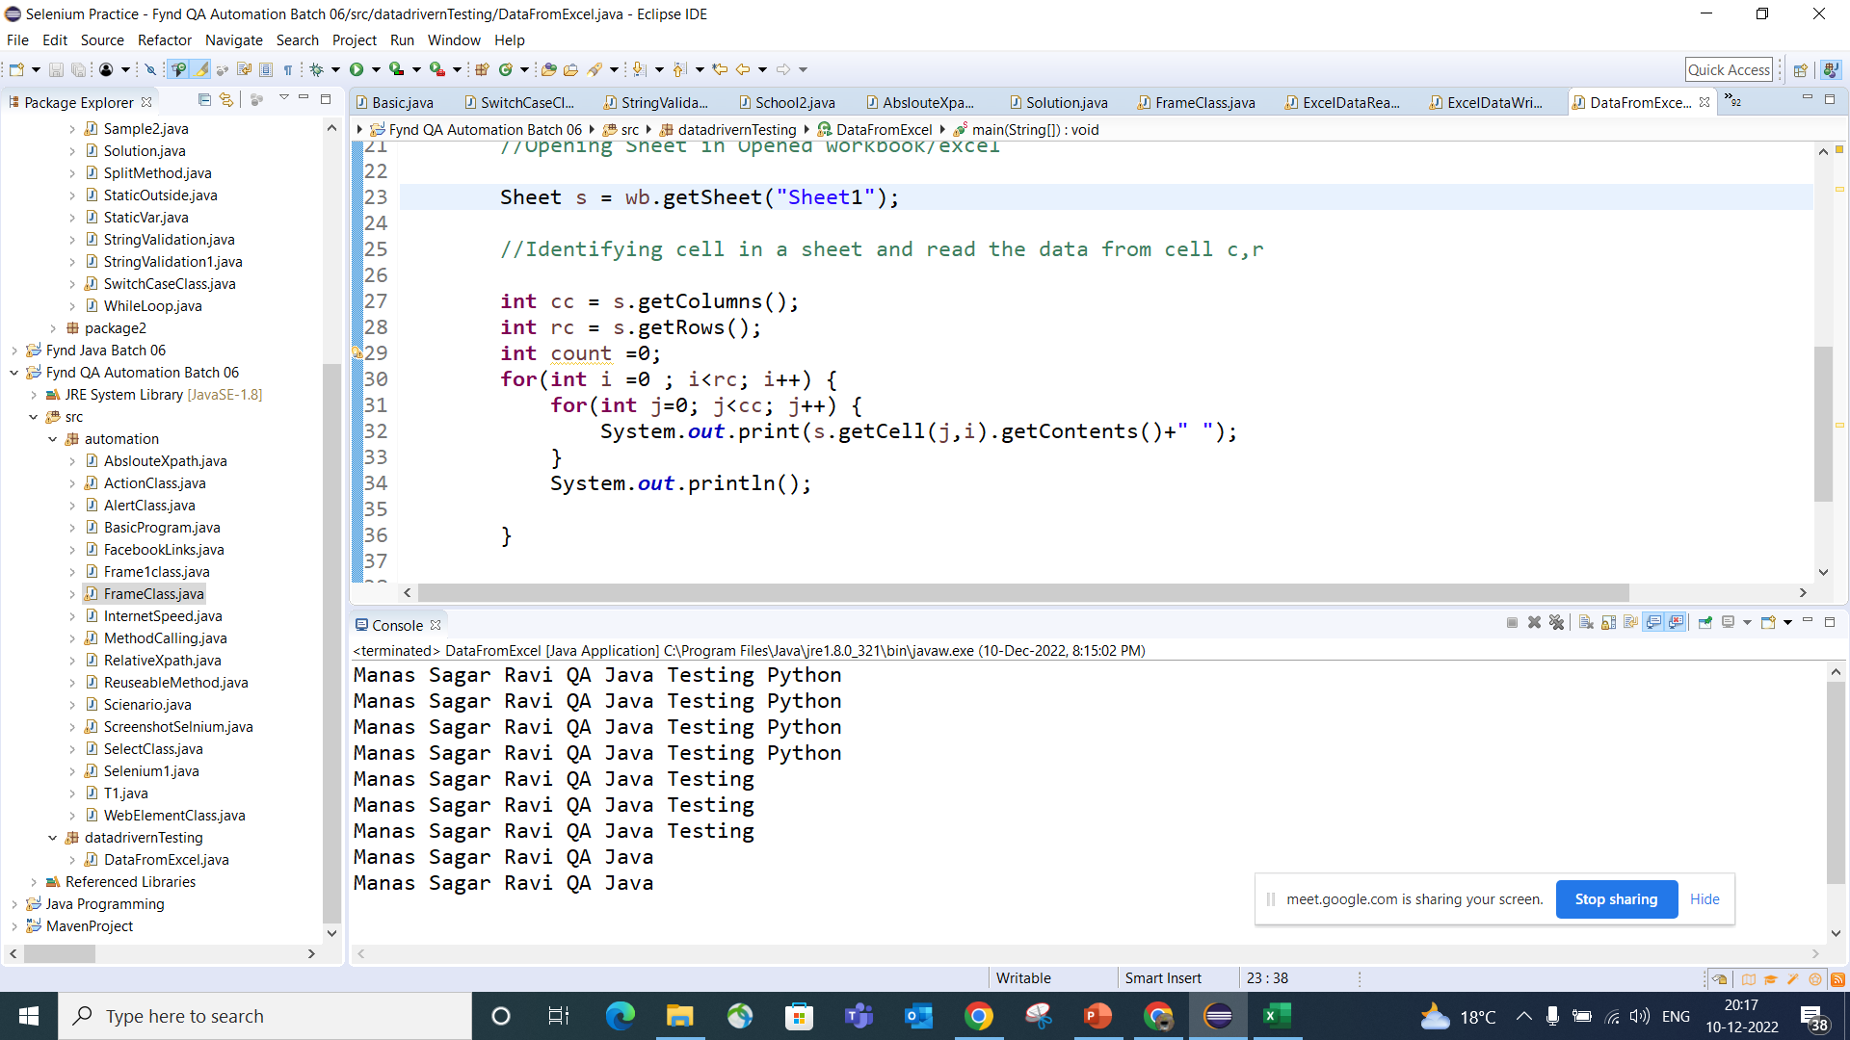

Slide 9
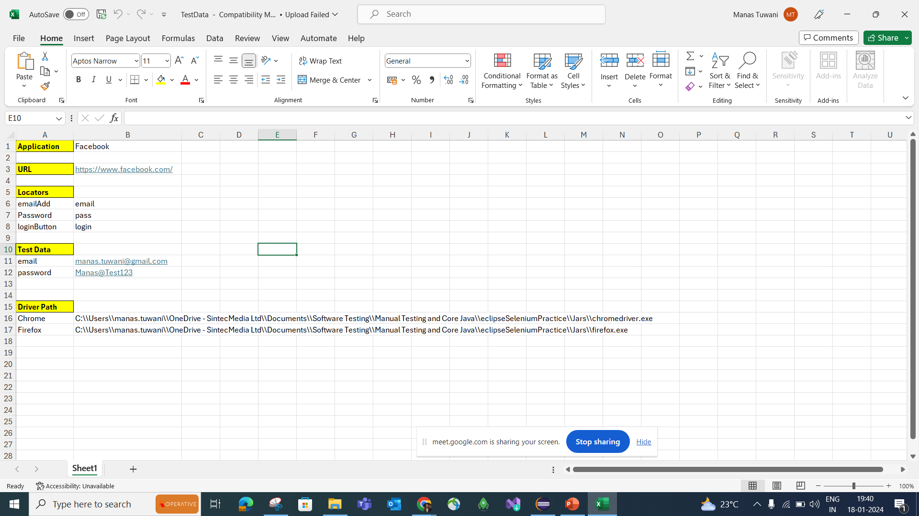

Slide 10
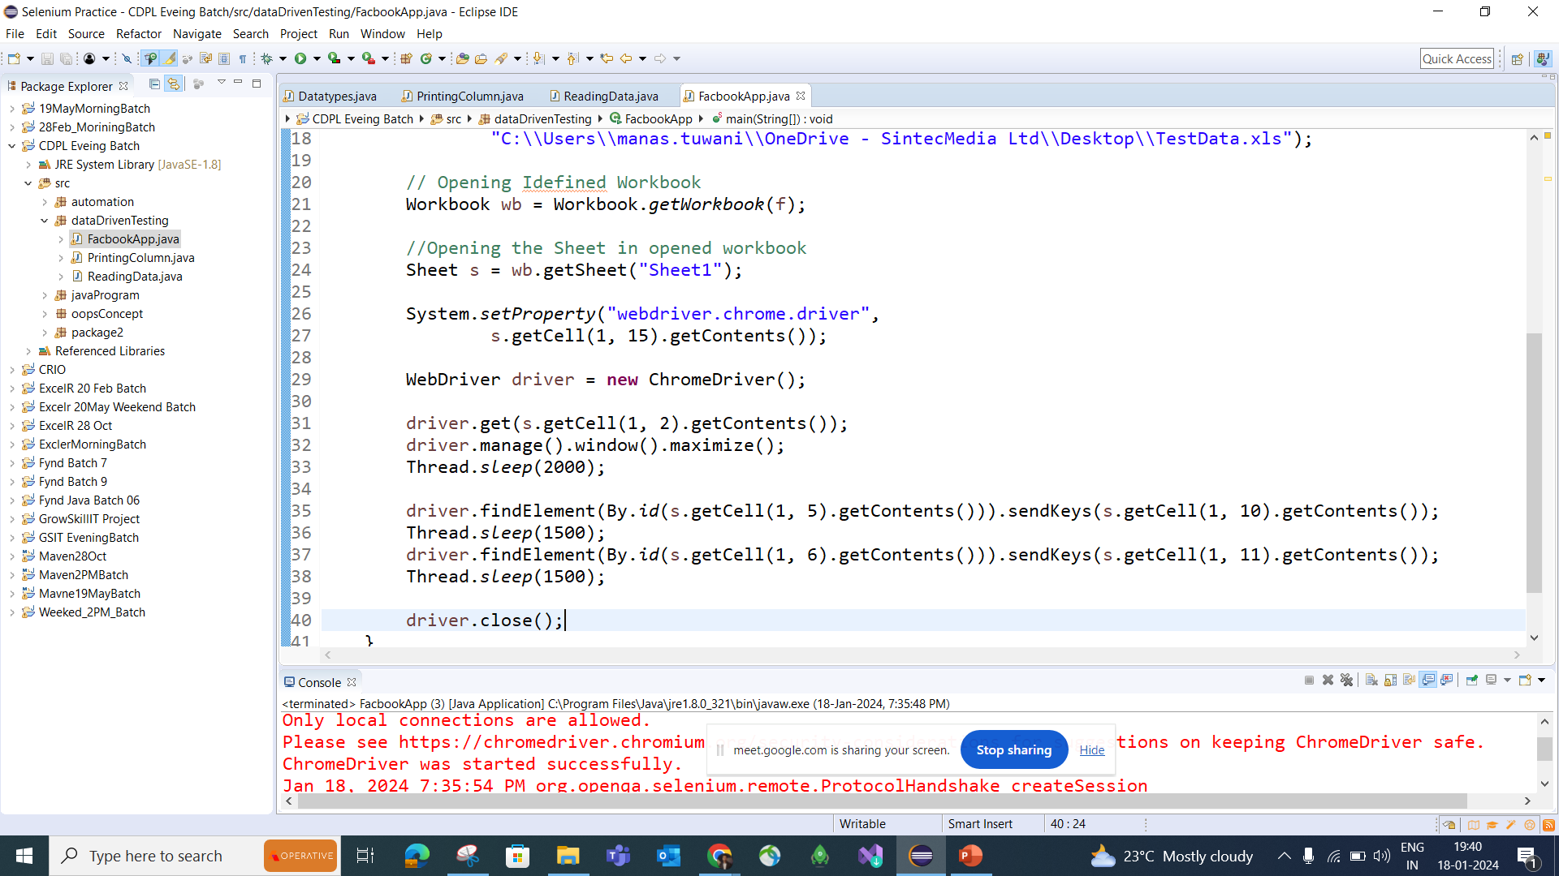

Slide 11
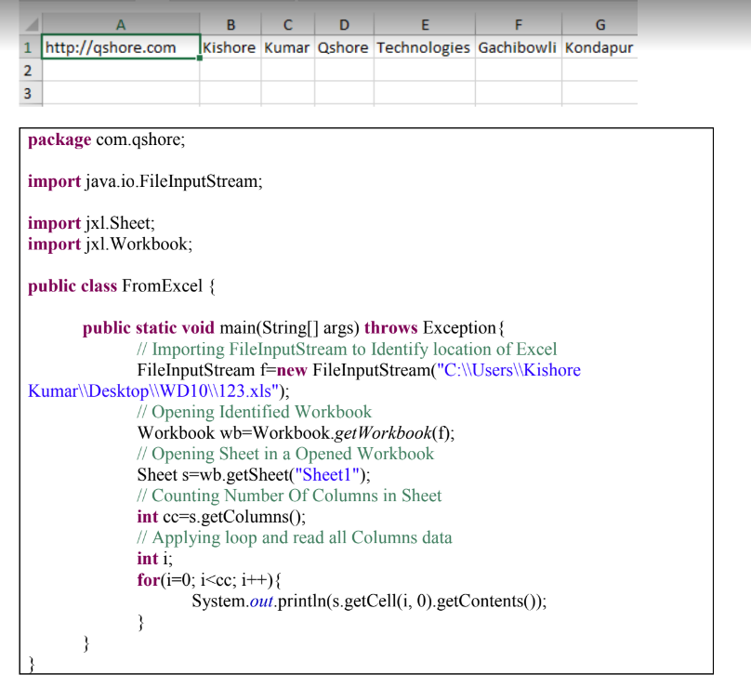

Slide 12

Writing Data into Excel:
We are using this option to write output into excel

Slide 13
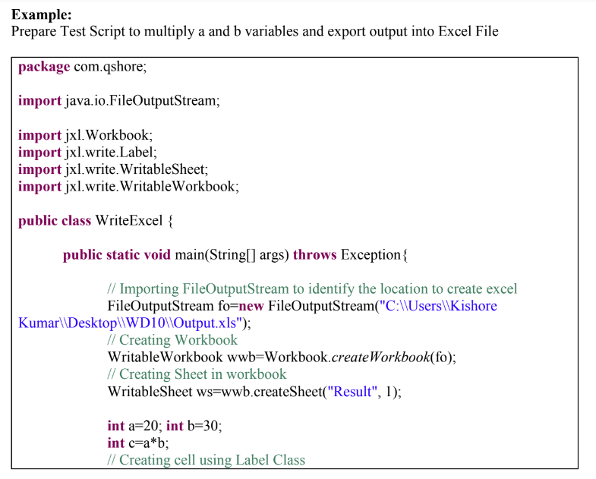
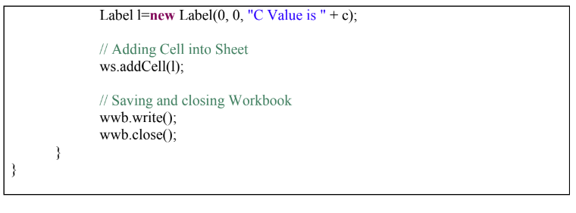

Slide 14
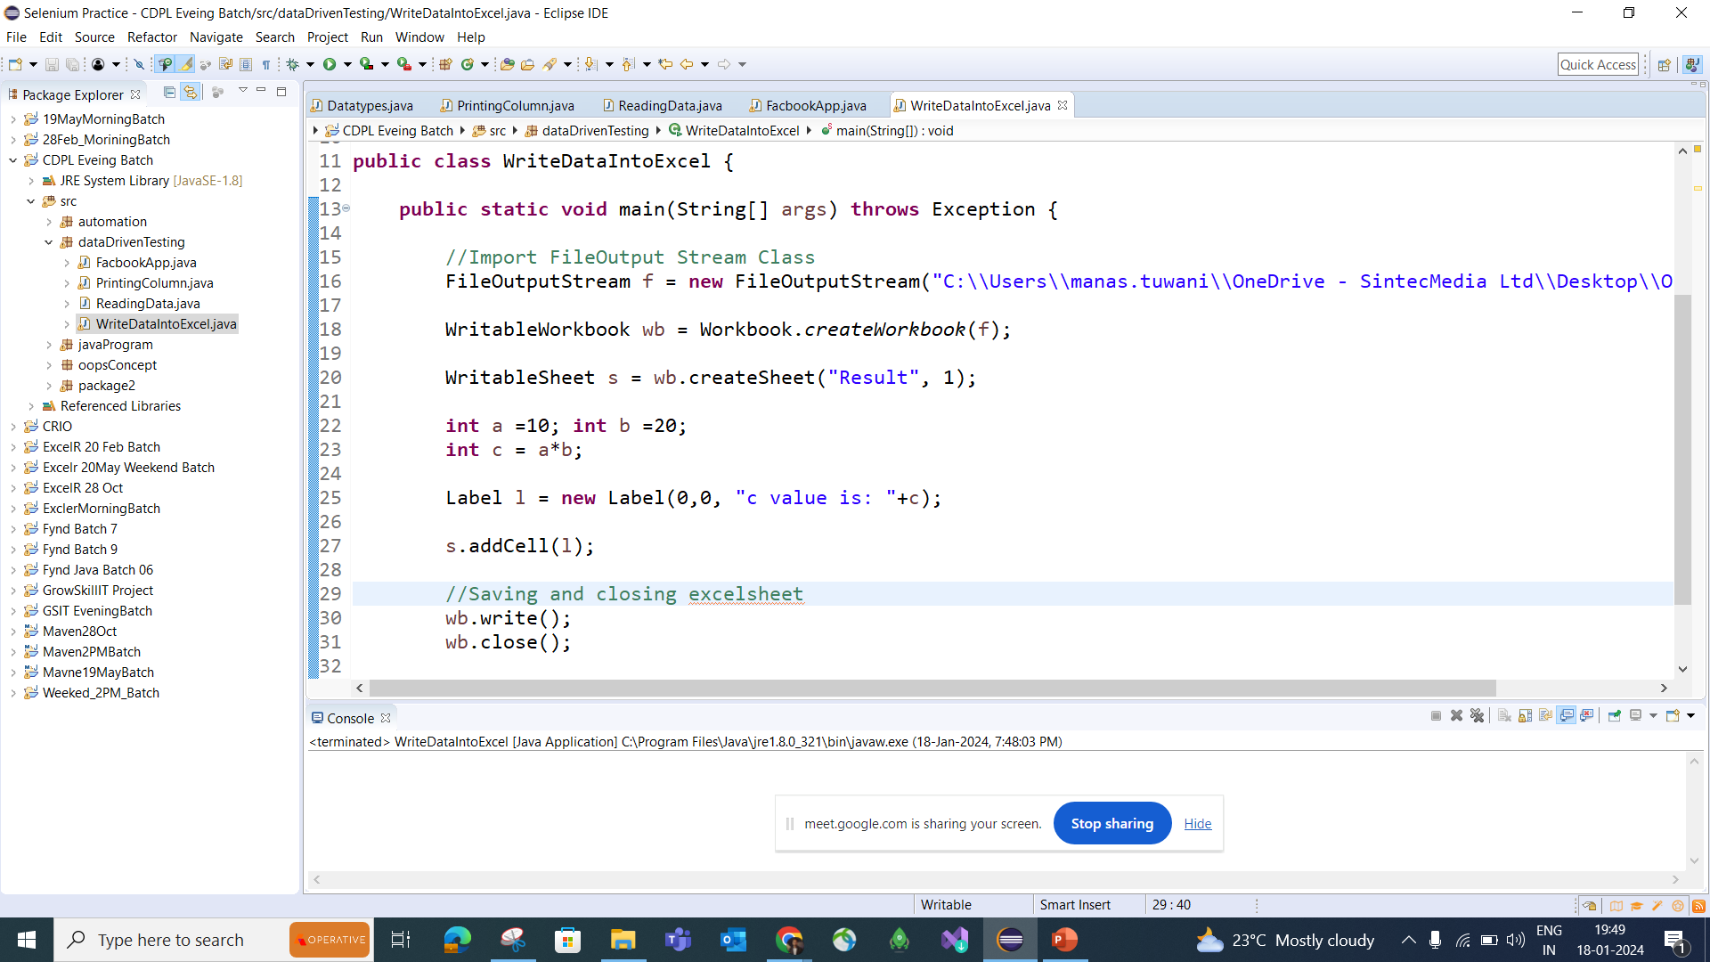

Slide 15
FAQ’s:
1. What is Data Driven Testing
2. How we are connecting to excel
3. Which jar file you are using to read data from excel
4. What is syntax for reading specific cell value in excel
5. Diff between FileInputStream and FileOutputStream class?

